Slide 1
Notes:
Hello, my name is Mr Kerrigan, I am a teacher at Branston Community Academy and the Coordinator and Manager of the Duke of Edinburgh’s Award (DofE) Scheme at BCA.
Today your child was introduced to the Duke of Edinburgh’s Award (DofE) in Assembly, here is some information for you are Parents and Carers to decide if you child should be enrolled onto the award programme.

Slide 2
What is the DofE?
The DofE is a life-changing adventure for young
people aged 14-24
It helps young people develop skills for their future life and work
Notes:
Doing their DofE is a brilliant way for your child/young person to discover just how much they are capable of. ​
It gives young people the chance to make new friends, follow their passions, learn new skills and make a difference in their community.
Gaining a DofE Award is a great way to impress future employers too. ​It helps them to stand out from the crowd when they apply for jobs, sixth form or college.
It’s also non-competitive and a powerful way for every young person to build belief in themselves, whatever their background, interests and abilities. ​ It is about personal achievement and developing their skills for the future.
​
​
​

Slide 3
Introducing the DofE
Notes:
The following film provides an overview of the Duke of Edinburgh's Award. ​Please watch it for an overview. It can also be found online at Welcome to DofE

Slide 4
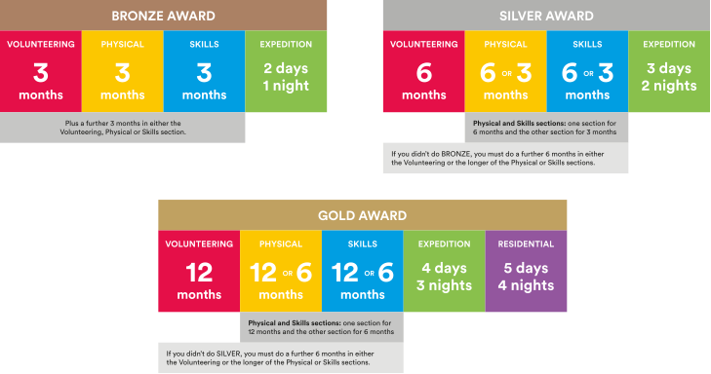
What is involved?
Notes:
There are three levels of DofE Award – Bronze, Silver and Gold. To achieve their Award, your child will need to complete four sections – Volunteering, Physical, Skills and Expedition (add residential for Gold). ​
​The length of time they will need to devote to each section will vary, depending on whether they are at Bronze, Silver or Gold level.​
Choosing which activities to do for each section may seem daunting for your young people. But it’s important to remember that most activities can count. Your child may already be doing an activity which they can use towards their DofE Award, or they may want to start something new.
Many young people will already take part in activities which can be counted towards their DofE Award, and there are a huge number of activities on offer for young people who are keen to try something new.​
​It is important to make sure that the young people are keeping a record of the time they spend on each activity. They may need your support to find an assessor for each section.
Assessors are people who check that activities have been completed and describe the progress that has been made. An assessor should be somebody who has a good understanding of the chosen activity. It can be anyone apart from members of your family.​
​I will now describe each section of the award in more detail.​
Your child has the opportunity to enrol on their Bronze award in year 9. If they complete the Bronze award, they can progress onto their Silver award in Year 10 and their Gold Award when they are 16.
The Awards are progressive, so they get more challenging as you move up them, they require a greater time commitment and the activities that the young people do should get progressively harder as they move up to Silver and then Gold. It is all about personal challenge though, so everyone is capable of achieving the different awards.
​

Slide 5
Volunteering section
Helping others and making a difference to the causes they care about
Notes:
Every young person who pursues a DofE award will be asked to devote some time to volunteering.​
​Through volunteering, young people have the opportunity to give up their time to help others or to make a difference to causes they feel passionate about.​
As well as changing things for the better, volunteering can be incredibly rewarding for young people – growing their confidence and sense of independence and gaining new skills they can use in their future lives and careers.​
​Examples of volunteering could be coaching a local football team, collecting items for a foodbank or campaigning for change on issues they feel passionate about.
​The amount of time young people will need to volunteer for will vary depending on whether they are pursuing a Bronze, Silver or Gold Award. ​
​Young people can choose to volunteer in any area they would like – the only rule is that young people must not be replacing paid labour, for example by volunteering for commercial organisations.​
It is not about work experience or unpaid work fro a business, but about helping the community.
​

Slide 6
Physical section
Improving their health and fitness and having fun along the way!
Notes:
A key component of any DofE Award is the Physical section, through which young people are encouraged to take part in regular physical activity. ​
​We know that regular physical activity improves young people’s physical and mental health so is a great habit to acquire when still young.​
​Almost any dance, sport or fitness activity can count – it’s completely up to them which activities they choose, including whether they seek to join a team or choose to do an activity on their own.​
​Completing the Physical section might be the push needed for a young person to try something completely different, or to concentrate and improve on something they are already doing. ​
​
The whole idea of the physical section is that it is physical, so it is exercise that raises the heartrate and gets them active. Activities in PE lessons do not count.
​

Slide 7
Skills section
Developing existing skills or discovering new things to love
Notes:
Through the skills section, young people are encouraged to develop a set of practical and social skills.​
​They will be able to choose whether to develop their skills in areas where they have an existing passion, or to learn about something new.​
In the past, young people have used their skills section to develop their interests and talents in a huge range of areas including computer coding, driving and cooking
​Through gaining interests and talents, young people will enjoy themselves and feel a real sense of achievement.​
​They’ll grow their confidence and show they’re committed, motivated and can rise to a challenge.​
​
​

Slide 8
Expedition
Spending time in the great
outdoors and creating
lifelong memories
Notes:
Young people taking part in a DofE Award will take part in an Expedition.​
​As part of a small team, they will plan their aim, choose their location, do some training to make sure they're prepared and know what they are doing.​
​The amount of time the young people spend away depends on the level of the award they are doing – it will be a minimum of 1 night for Bronze, 2 nights for Silver and 3 nights for Gold.​
​They can choose how they want to travel – it doesn’t have to be on foot. They could do it by bike, canoe, kayak, wheelchair, sailing boat or even on a horse.​
​The expedition is an incredible experience which will help your young person develop resilience, communication, teamwork and leadership skills. ​

Slide 9
Your role
Guidance
Encouragement
Practical support
Recognising achievement
Notes:
There are several ways you can help your young person to achieve their DofE Award.​
​You should provide guidance and advice – support them with things like choosing their activities and finding assessors.
Encouragement - It can be challenging to keep the motivation going, especially over some of the longer timeframes.​
​If they need it, help keep them on track with their activities, particularly those which are being done from home.​
​Practical support - You may be required to drop off/collect from expeditions and activities, make sure they have all the right kit and also wash the kit when it comes home! ​
​Recognising achievement - We hope all organisations will recognise the amazing achievement, and it is just as important to receive that recognition from family members. ​
​

Slide 10
Your Welcome Pack and eDofE
Notes:
Once your child/young person has signed up to do their DofE, Making payment on Parent Pay and completing the enrolment form, they’ll get their own eDofE account. This will help them to plan their activities online and using the free DofE app. ​
​Participants can use the DofE app to plan activities, get approval from Leaders, record evidence, submit programmes for completion and more.​
​They will also receive a Welcome Pack in the post which contains a wide range of information and advice as well as some more information for parents/carers. ​
​All participants will also be sent a personalised DofE Card to give them and their families discounts at several recommended retailers. Young people at Gold Award level will also be eligible for a discount on their car insurance.​
Please be aware that enrolling on the award does not mean that your child will automatically complete their award, it is a test of commitment and your child will be supported in completing their award by myself and my team, but ultimately it is up to them to do the activities, collect evidence and get an assessor to write a report. They may need your support to remind them to do these things.
​

Slide 11
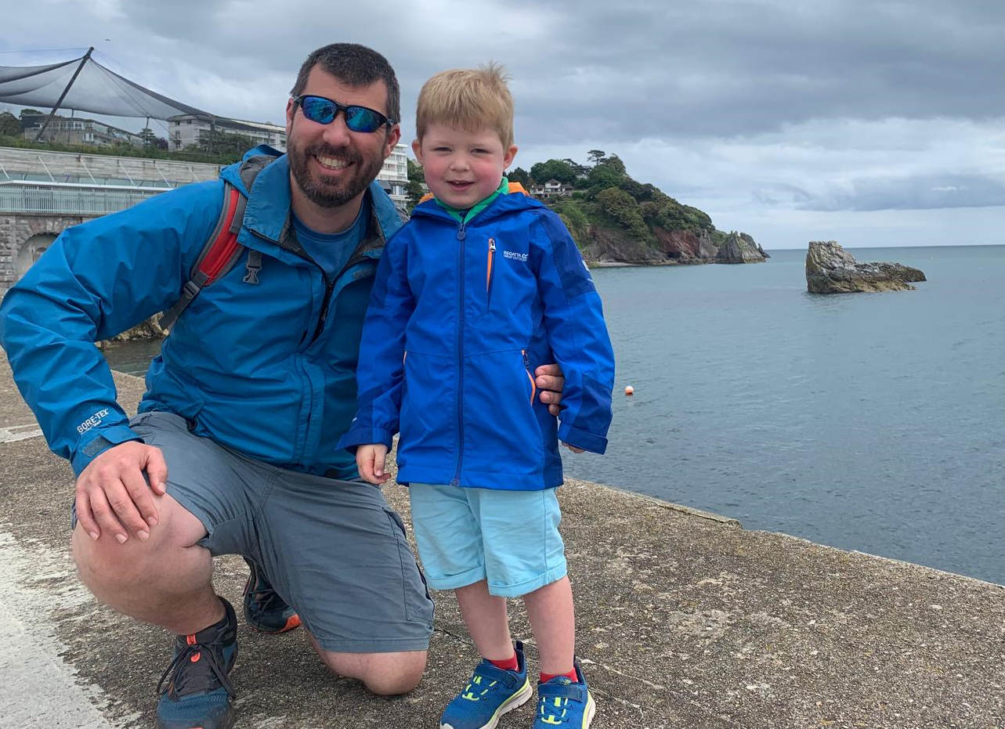
Getting started
Are you ready to support your
child/young person to start an adventure they’ll never forget?
To get started speak to
Mr Kerrigan
Mr Kerrigan
DofE Co-Ordinator/ Manager
I completed by DofE Bronze, Silver and Gold award. Being presented my Gold at St James Palace by Prince Philip in 2004. I have done expeditions walking, canoeing and rowing. For my other sections I did activities such as photography, kayaking and boatwork.
I am a Mountain Leader and DofE expedition assessor.
I have been helping young people achieve their Duke of Edinburgh award for 22 years.
The DofE is a charity. Visit DofE.org for more information.
Notes:
Please see details for enrolling on the Bronze award on the next two slides.
Please start a conversation with your young person about what activities they might choose for their DofE, if they are interested in completing the award.

Slide 12
What to do now.
If you have any questions please email Mr Kerrigan at DofE@branstonca.lincs.sch.uk
If you have spoken to your child and they would like to enrol onto the award please complete the application form:
And make payment of £28 on ParentPay for the registration of the award.
Talk to your child, what could they do for their different sections?
Once your child has been enrolled onto their Bronze Award they will
receive an email welcoming them to the award and a welcome pack.
They will then have an introduction session at school.
Notes:
Please see enrolment process above.

Slide 13
The Expedition Section
You child will receive training in afterschool sessions, this will complete the Expedition Training Framework, so that they have the skills to safely participate in the expedition through school.
There will be a Residential Training sessions (overnight camping).
There will be a training day walk.
There will be a two day, 1 night qualifying expedition.
Dates will be confirmed.
Your child will have to complete all of the above to complete their expedition with us.
If numbers have to be limited for the residential training and expedition, priority will be given to those who have engaged and made progress with completing their other sections of the award.
Notes:
Here at Branston Community Academy we complete the Bronze expedition by foot. We will have afterschool training sessions one evening a week starting in the new year, this will allow us to train your child to ensure that they have the skills and knowledge to safely carry out the expedition section, as it will involve periods of ‘remote supervision’, where the staff are not walking with them, but meet up with them along your journey to check in on them. There will be a days navigation training on a Saturday, where they are taken on a walk by a member of staff and their map reading skills are developed. There will also be a overnight training session, where students will camp at the school over night on the Friday after school and spend the day on Saturday continuing their training. All dates to be confirmed in the new year. Attendance of all the training is essential to allow your child to attend the qualifying expedition.
The cost of BCA providing this opportunity will be around £70 per person on top of their registration and enrolment fee. If this is a problem for you, your child may be eligible for financial assistance through the Duke of Edinburgh’s award and we can signpost you to that support if required.
If you would prefer your child to complete their expedition section by an alternative means of transport (rowing, sailing, paddlesport, mountain biking or house riding), these can be done, but we are not able to support this and it would incur additional costs to yourself.
If numbers have to be limited for the residential training and expedition, priority will be given to those who have engaged and made progress with completing their other sections of the award.
​
​

