Slide 2
What is the DofE?
The DofE is a life-changing adventure.
You make it: The DofE is as unique as you are
Millions of young people in the UK have already done their DofE.
Now it’s your turn.
Notes:
The DofE is a life-changing adventure which will help you develop the skills you need for your future life and work. ​
The DofE gives you the chance to discover just how much you’re capable of.
It’s a great way to meet new people, try new things, do what you love and make a difference in your community.

Slide 3
Introducing the DofE
Notes:
The following film provides an overview of the Duke of Edinburgh's Award. ​Please watch it for an overview. It can also be found online at Welcome to DofE

Slide 4
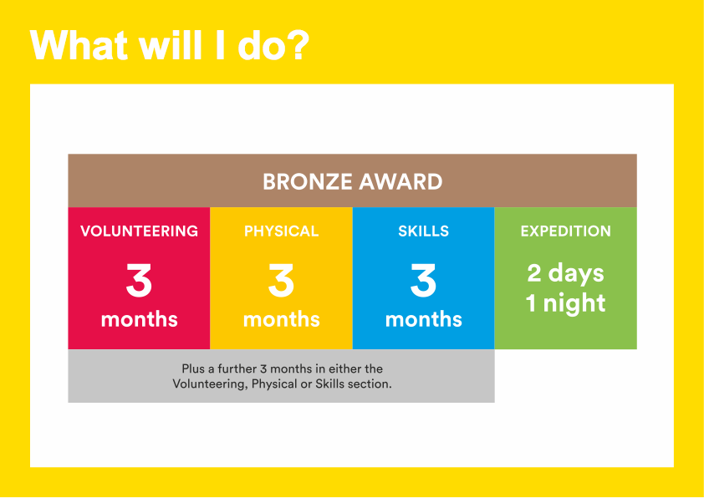
Notes:
To achieve your DofE Bronze Award, you will need to complete four sections – Volunteering, Physical activity, developing a skill and the Expedition.​
Activities for each section take a minimum of one hour a week, so they can easily fit in around your studies and other interests.​
You will need to spend at least 3 months completing each of the Volunteering, Physical and Skills sections.
You will also need to decide which one of these you would like to do for six months.​
You will need to keep a record of the time you spend on each activity.
You should ask somebody who has a good understanding of the activity you have chosen to write a report describing what you have done.​
It may seem daunting at first but remember that most activities can count towards your DofE.
I will now describe each section of the award in more detail.

Slide 5
Volunteering section
Take action and make a difference to the causes you care about
Help others and change things for the better
Notes:
As part of your Bronze DofE Award, you will need to donate some of your time to volunteering.​
Volunteering is a chance to help other people, and to make a difference to the causes you feel most passionate about.​
As well as changing things for the better, lots of young people find that volunteering is a great way to increase their confidence and gain new skills.​
Examples of volunteering could be coaching a local football team, collecting items for a foodbank or campaigning for change on issues you feel passionate about
Presenter: Feel free to include a broad range of examples here and to talk about what previous participants have done.
You can choose to volunteer in any area you would like – the only rule is that you must not be doing a job that companies would normally pay somebody for.​

Slide 6
Physical section
Take part in whatever
dance, sport or ﬁtness
activity you would like
Get ﬁtter and have fun along the way!
Notes:
To complete the Physical section of your Bronze Award, you will have the opportunity to take part in regular physical activity.
Becoming more active can be a huge amount of fun, and it can also help you feel happier and healthier.
Almost any dance, sport or fitness activity can count — it’s completely up to you which activities you choose.
You may decide to join a team or to do something on your own.
You may like to try something completely different, or to concentrate and improve on an activity you already do.
​

Slide 7
Skills section
Devote yourself to improving your skills in the things you love to do
Discover new passions and develop talents you didn’t know you had
Notes:
Through the Skills section, you will be encouraged to develop your practical and social skills in an area you can choose.
You can decide whether you will try to get better at something you already feel passionate about, or learn to do something new.
In the past, young people have done a huge range of different activities for their skills section, such as computer coding, driving and cooking.
Presenter: Please add in your own examples here.
Gaining new interests and talents is a huge amount of fun and lots of young people also feel a real sense of achievement from doing it.
​

Slide 8
Expedition
Explore the great outdoors and spend a night away from home
Create memories that will last a lifetime
Notes:
The final section of your Bronze DofE Award is the Expedition.​
​As part of a small team, you’ll plan your aim, choose your location and do some training to make sure you’re prepared and know what you’re doing — then spend two days and one night away.​
​You can choose how you want to travel – it doesn’t have to be on foot. You could do it by bike, canoe, kayak, wheelchair, sailing boat or even on a horse.​
​Your Expedition will improve your resilience, communication, teamwork and leadership skills. ​
​Presenter: Please take care to place the same level of emphasis on each of the four sections. Whilst some young people may be attracted to the DofE because of the expedition, we know that some young people find this element daunting, so may need careful reassurance.
​

Slide 9
Your Welcome Pack and eDofE
Notes:
Once you have signed up to do your DofE, you will receive a Welcome Pack in the post which contains lots of useful information and advice. ​
​You will also get your own eDofE account so that you can plan your activities online using the free DofE app.​
​You will also receive a DofE Card which will give you and your family money off in several shops selling the sorts of equipment you may need.​

Slide 10
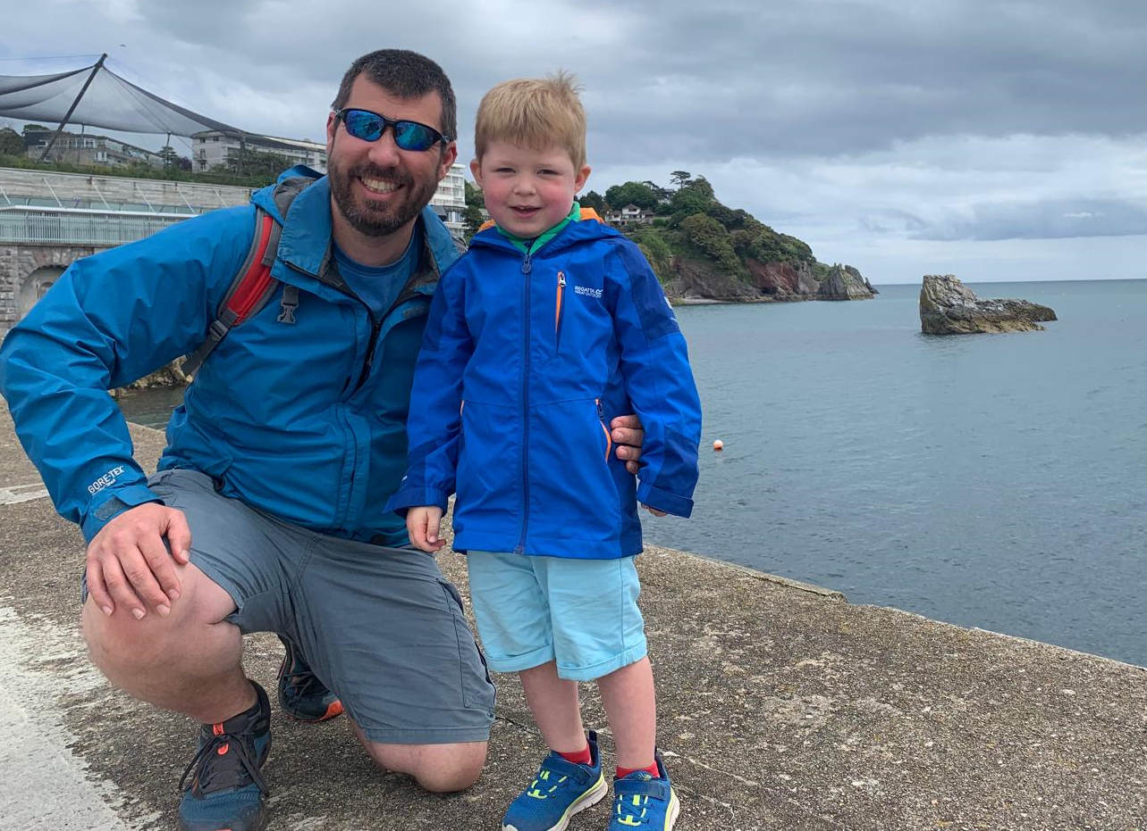
Getting started
Are you ready to start an adventure you’ll never forget?
To get started with your DofE,
speak to Mr Kerrigan.
Miss Slesser or
Miss Sheard.
Mr Kerrigan
DofE Co-Ordinator/ Manager
I completed by DofE Bronze, Silver and Gold award. Being presented my Gold at St James Palace by Prince Philip in 2004. I have done expeditions walking, canoeing and rowing. For my other sections I did activities such as photography, kayaking and boatwork.
I am a Mountain Leader and DofE expedition assessor.
I have been helping young people achieve their Duke of Edinburgh award for 22 years.
The DofE is a charity. Visit DofE.org for more information.
Notes:
Presenter: Please customise this slide with the contact details of your DofE leader/administrator.
​Explain the next steps.
Bronze | start your DofE
​Outline your organisation’s process for signing up to DofE.​
​
​

Slide 11
Start your DofE Today
Notes:
The following film provides an overview of the Duke of Edinburgh's Award. ​Please watch it for an overview. It can also be found online at Welcome to DofE

